Slide 1

CSE 350 Digital Electronics and Pulse Techniques
Prerequisite:
CSE 251 : Electronic Devices and Circuits,
CSE 260 : Digital Logic Design
Mail: shomen.kundu@bracu.ac.bd
Desk: #4N166 Course Instructor: Shomen Kundu (SDU)

Slide 2
Marks Distribution
Attendance : 0 ( Required greater than 70 %)
Assignment : 10
Quiz : 20
Lab : 25
Midterm : 25
Final : 25
_____________________
Total : 100

Slide 3
CSE 350: Digital Electronics and Pulse Techniques (3 Credits)
Diode logic gates, transistor switches, transistor gates, MOS gates, Logic families: TTL, ECL, IIL and CMOS logic with operation details. Propagation delay, product and noise immunity. Open collector and High impedance gates. Electronic circuits for flip flops, counters and register, memory systems. PLA's (A/D, D/A converters with applications, S/H circuits) LED, LCD and optically coupled oscillators. Non-linear applications of OPAMPs. Analog switches. Linear wave shaping: diode wave shaping techniques, clipping and clamping circuits, comparator circuits, switching circuits. Pulse transformers, pulse transmission. Pulse generation:monostable, bistable and stable multivibrations, Timing circuits. Simple voltage sweeps, linear circuit sweeps. Schmitrigger, blocking oscillators and time base circuit. The course includes a compulsory 3 hour laboratory work each week. (Pre req. CSE 251, CSE 260)
Suggested Books: 1. Jacob Millman," Microelectronics: Digital and Analog Circuits and Systems", McGraw-Hill, 1979.

Slide 4
Tentative Mid and Final Syllabus
Mid
ADC: Intro (Sampling, Quantization, Encoding) + Flash ADC + Dual Slope ADC
DAC: Binary Weighted DAC + R2R DAC
Schmitt Trigger: Inverting & Non-inverting (with & without applied voltage)
Signal Generators: Triangular + Square Wave Generator
Final
Diode Logic: OR & AND Gates [Basic Operation & Power Dissipation]
RTL: NOT & NOR Gates [Basic Operation, Power Dissipation, Noise Margin, Fanout]
DTL: NAND Gate [Basic Operation, Power Dissipation, Fanout]
TTL: NAND Gate [Basic Operation, Power Dissipation]
NMOS: NOT & NOR Gates (Resistive+Enhancement+Depletion Loads)[Basic Operation, Power Dissipation]
CMOS: Logic Function Implementation

Slide 5
Course Content
1. Digital Electronics ( 70 % )
i. Logic families
ii. DC analysis of these circuits
2. Pulse Techniques ( 30 %)
i. Signal generator
ii. ADC
iii. DAC

Slide 6
Review ( Circuits and Electronics )
Ohm’s law
KCL
KVL
Node Analysis

Slide 7
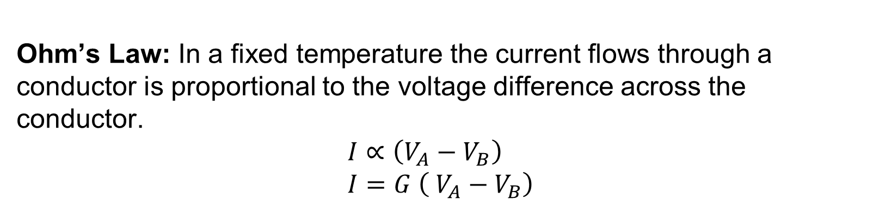
Review ( Circuits and Electronics )
Ohm’s Law: In a fixed temperature the current flows through a conductor is proportional to the voltage difference across the conductor.
$$I∝\left(V_{A}−V_{B}\right) \\ I=G \left( V_{A}−V_{B}\right)$$
V_{A} > V_{B}
V_{A}
V_{B}
_{I}

Slide 8
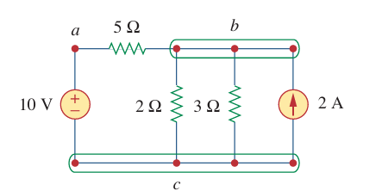
Review ( Circuits and Electronics )
Node : Interconnected points between two and more electrical component.

Slide 9
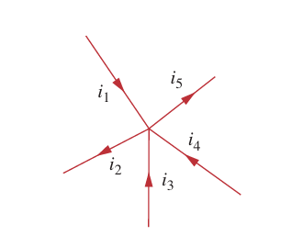
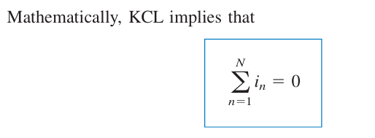
Review ( Circuits and Electronics )
Kirchhoff’s current law (KCL): states that the algebraic sum of currents entering a node (or a closed boundary) is zero.
Convention: a. Current Entering a node is positive
b. Current Exiting a node positive

Slide 10
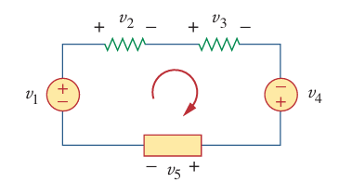
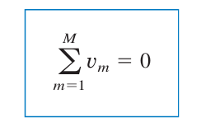
Review ( Circuits and Electronics )
Kirchhoff’s voltage law (KVL) states that the algebraic sum of all volt ages around a closed path (or loop) is zero.

Slide 11
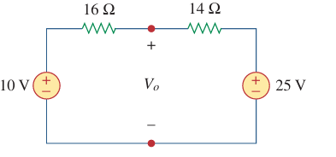
Review ( Circuits and Electronics )
Example: Find the value of I for the below circuit.
i

Slide 12
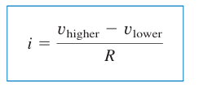
Review ( Circuits and Electronics )
Node Analysis: Goal -> Finding “node voltage”
Techniques -> KCL and Ohm’s Law
Step:
Identify reference voltage
Identify unknown node voltage
Write the node equation
Solve the node equation

Slide 13
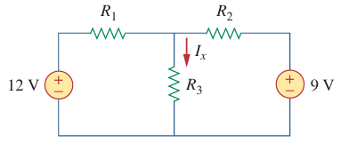

Review ( Circuits and Electronics )
Example: Find the voltage of the node a. Given $R_{1}=10Ω$, $R_{2}=5Ω$and $R_{3}=20Ω$.
a

Slide 14
Review ( Electronic Circuits and Devices)
Semiconductor ( Si )
Intrinsic Semiconductor: pure semiconductor crystal
Extrinsic Semiconductor: impurity is being added.
Extrinsic Semiconductor is of two types:
n-type: Majority electron, Minority hole
p-type: Majority hole , Minority electron

Slide 15
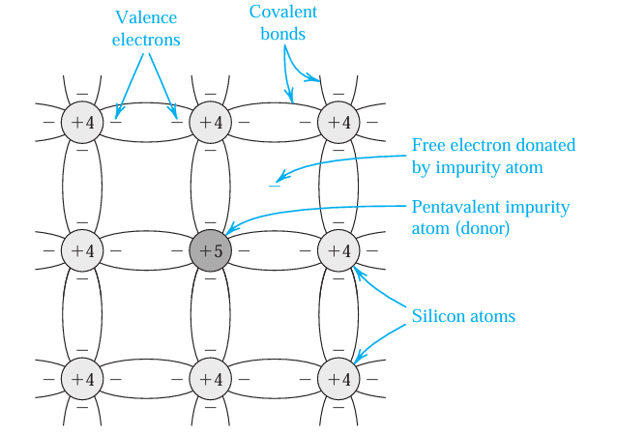
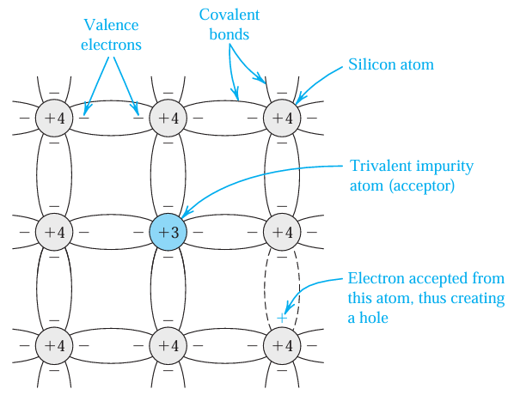
Review ( Electronic Circuits and Devices)
Fig: n-type [ Si + group V ( P, As, Sb ) ]
Fig: p-type [ Si + group III (B,Ga) ]

Slide 16
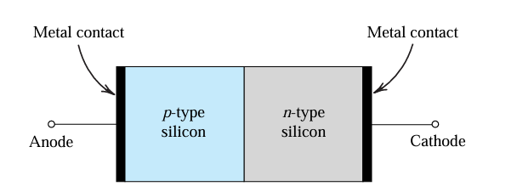
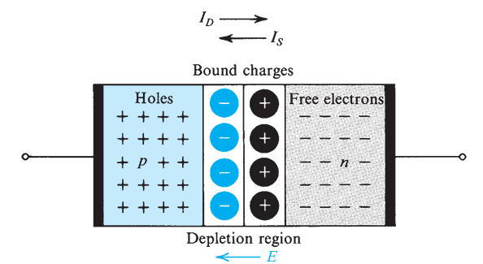
Review ( Electronic Circuits and Devices)
Diode:
Fig: Simplified physical structure of the pn junction.
Fig: pn junction with no applied voltage

Slide 17
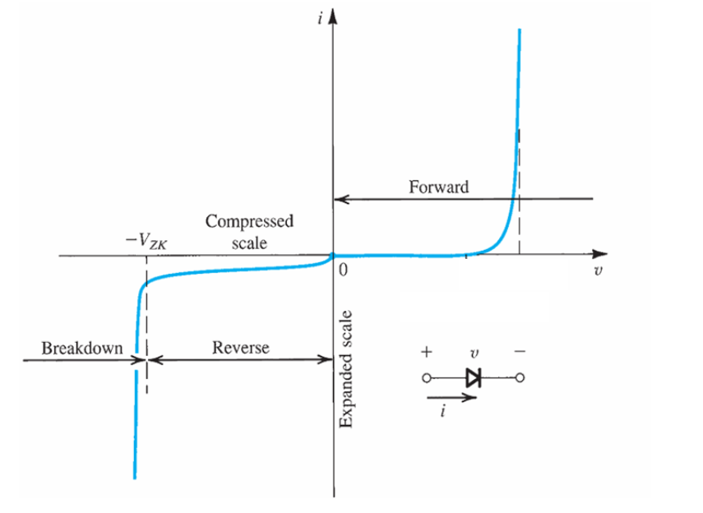
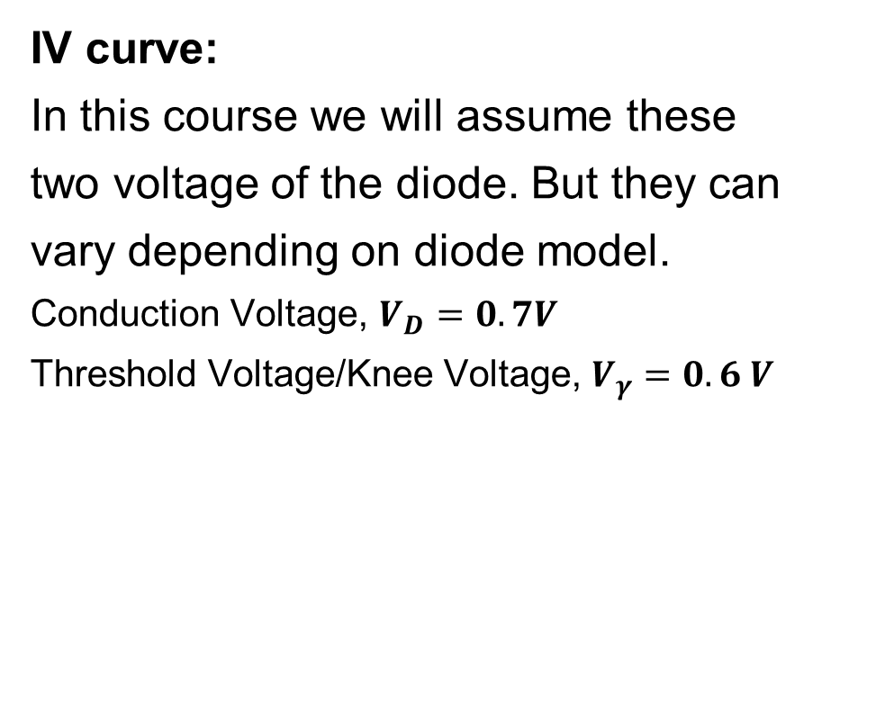
Review ( Electronic Circuits and Devices)
IV curve:
In this course we will assume these
two voltage of the diode. But they can
vary depending on diode model.
Conduction Voltage, $V_{D}=0.7V$
Threshold Voltage/Knee Voltage, $V_{γ}=0.6 V$
Fig: The I-V characteristic of the pn junction showing the rapid increase in reverse current in the breakdown region.

Slide 18
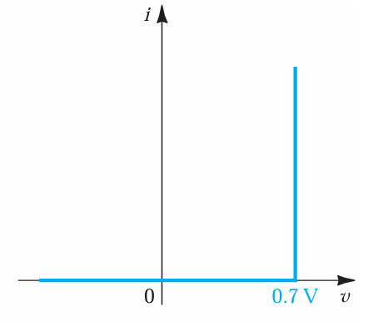
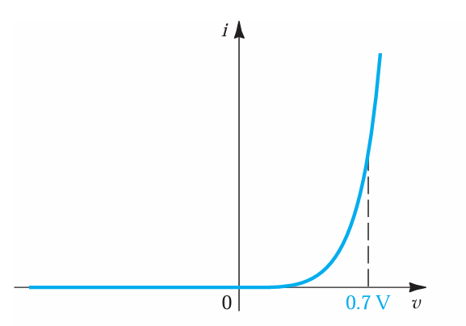

Review ( Electronic Circuits and Devices)
The Constant-Voltage-Drop Model:
The simplest and most widely used diode model is the constant-voltage-drop model. This model is based on the observation that a forward-conducting diode has a voltage drop that varies in a relatively narrow range, say 0.6 to 0.8 V. The model assumes this voltage to be constant at a value, say, $V_{D}=0.7 V$.

Slide 19
Review ( Electronic Circuits and Devices)
Conductance voltage (V_{D}) of different diode for constant voltage drop model:
Ideal diode: V_{D} = 0 V
Ge diode: V_{D} = 0.3 V
Si diode: V_{D} = 0.7 V (will be used most of the time )
We will use Si diode with constant voltage model for simplicity. If nothing is mentioned in the question, we will assume Si diode.

Slide 20
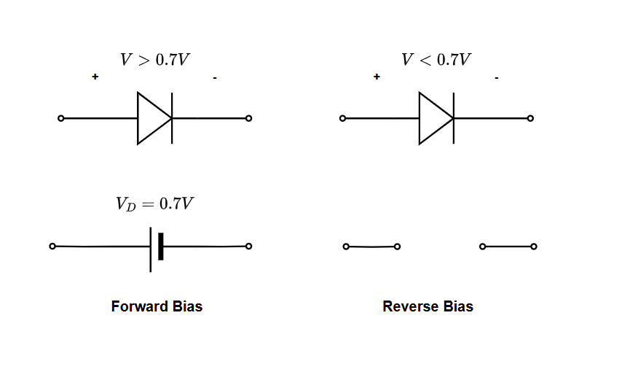
Review ( Electronic Circuits and Devices)
Equivalent circuit of Si diode for constant voltage drop model:

Slide 21
Review ( Electronic Circuits and Devices)
Transistors are three terminal devices
BJT: Used in switching and amplification for audio and analog circuits.
FET: Ideal for analog switches and high-impedance amplifiers.
MOSFET: Key in digital circuits, power electronics, and RF amplification.
Bipolar devices both electron and hole take part in current conduction for example BJT.
Unipolar either electron or hole takes part in current conduction for example MOSFET.

Slide 22
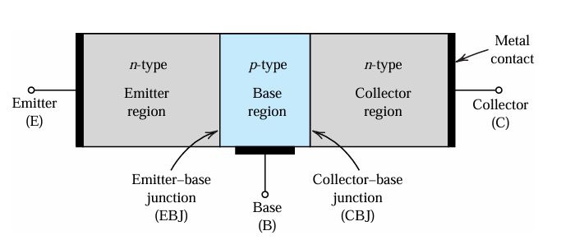
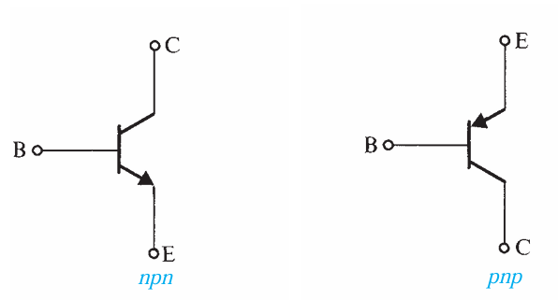
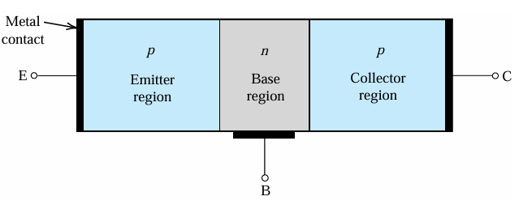
Review ( Electronic Circuits and Devices)
BJT: The transistor consists of two p-n junctions, the emitter–base junction (EBJ) and the
collector–base junction (CBJ). Depending on the bias condition (forward or reverse) of
each of these junctions, different modes of operation of the BJT are obtained.
Length: LC>LE>LB and Doping : NE > NC >NB
That’s why BJT is not symmetrical
Arrow indicate the Emitter terminal

Slide 23
Review ( Electronic Circuits and Devices)
Modes of BJT
EB Junction | CB Junction | Mode | Use
Forward | Reverse | Active | Amplifier
Forward | Forward | Saturation | Switch
Reverse | Reverse | Cut off | Switch
Reverse | Forward | Reverse Active | No use

Slide 24


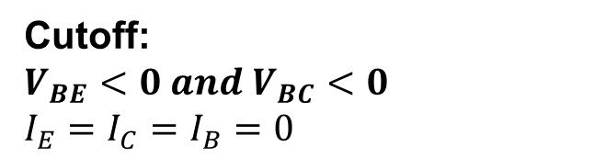

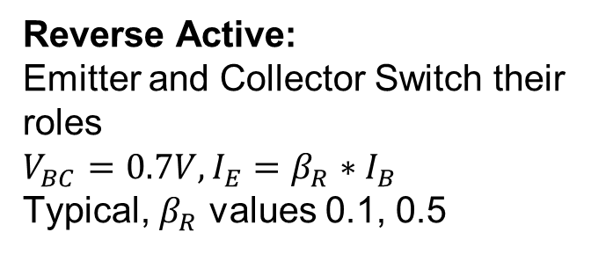
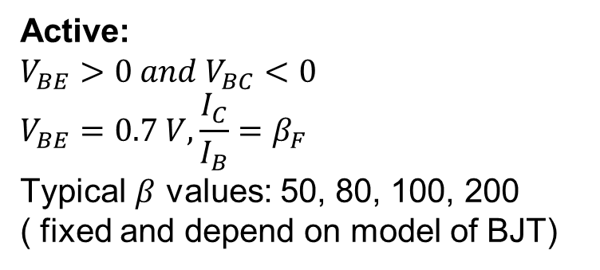
Review ( Electronic Circuits and Devices)
Reverse Active:
Emitter and Collector Switch their roles
$V_{BC}=0.7V, I_{E}=β_{R}∗I_{B}$
Typical, $β_{R}$ values 0.1, 0.5
Saturation:
$$V_{BE}=0.8 V, V_{CE}=0.1 −0.2 V$$
Checking condition:
$$\frac{I_{C}}{I_{B}}=β_{forced}<β_{F} ( forward)$$
Cutoff:
$$V_{BE}<0 and V_{BC}<0$$
$$I_{E}=I_{C}=I_{B}=0$$
Active:
$$V_{BE}>0 and V_{BC}<0$$
$$V_{BE}=0.7 V,\frac{I_{C}}{I_{B}}=β_{F}$$
Typical $β$ values: 50, 80, 100, 200
( fixed and depend on model of BJT)
CSE 350

Slide 25
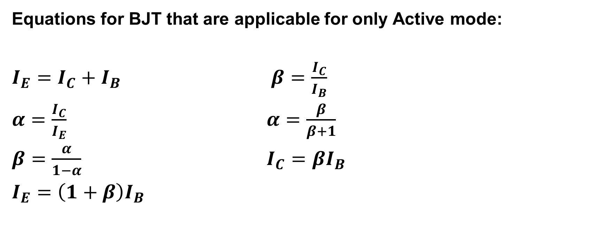
Review ( Electronic Circuits and Devices)
Equations for BJT that are applicable for only Active mode:
$I_{E}=I_{C}+I_{B}$ $β=\frac{I_{C}}{I_{B}}$
$α=\frac{I_{C}}{I_{E}}$ $α=\frac{β}{β+1}$
$β=\frac{α}{1−α}$ $I_{C}=βI_{B}$
$I_{E}=\left(1+β\right)I_{B}$

